Slide 1

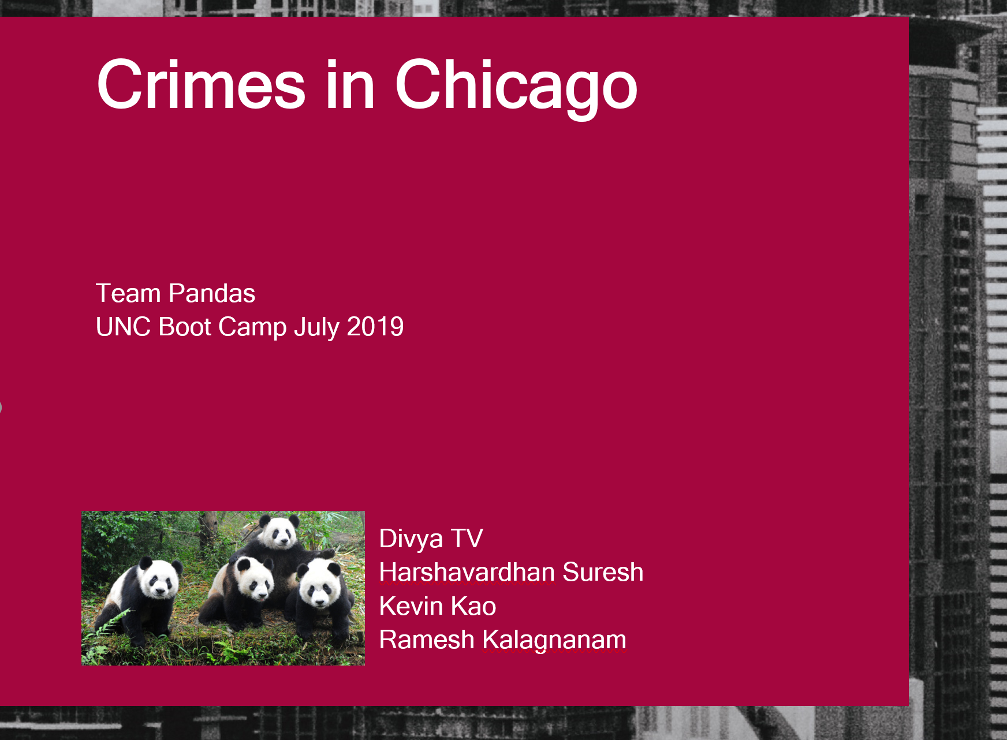



Project 01- Crimes in Chicago from 2001 to 2019

Slide 2
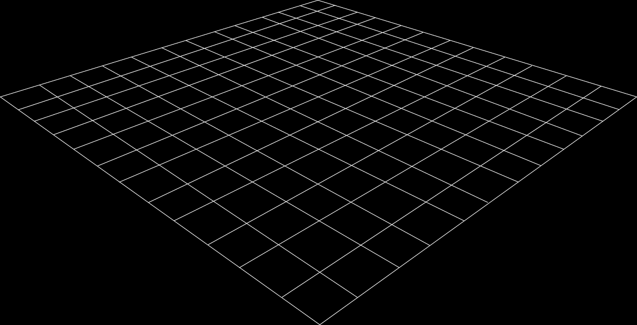
OBJECTIVES
Speaker: Ramesh
Determine relationships between criminal activity and weather conditions.
Determine crime counts for each month for selected crime types breaking down the timeline based dynamic user request
Determine relationship between popular attractions and criminal activity.
Use google maps to provide details of safe and unsafe places in Chicago for a user specified timeline.
Fact checking from Wikipedia. Plots showing numbers which match news articles.
Where do most crimes occur? Example: Street, parking lot, airport, gas station, residence, bar or tavern, schools etc.

Slide 3
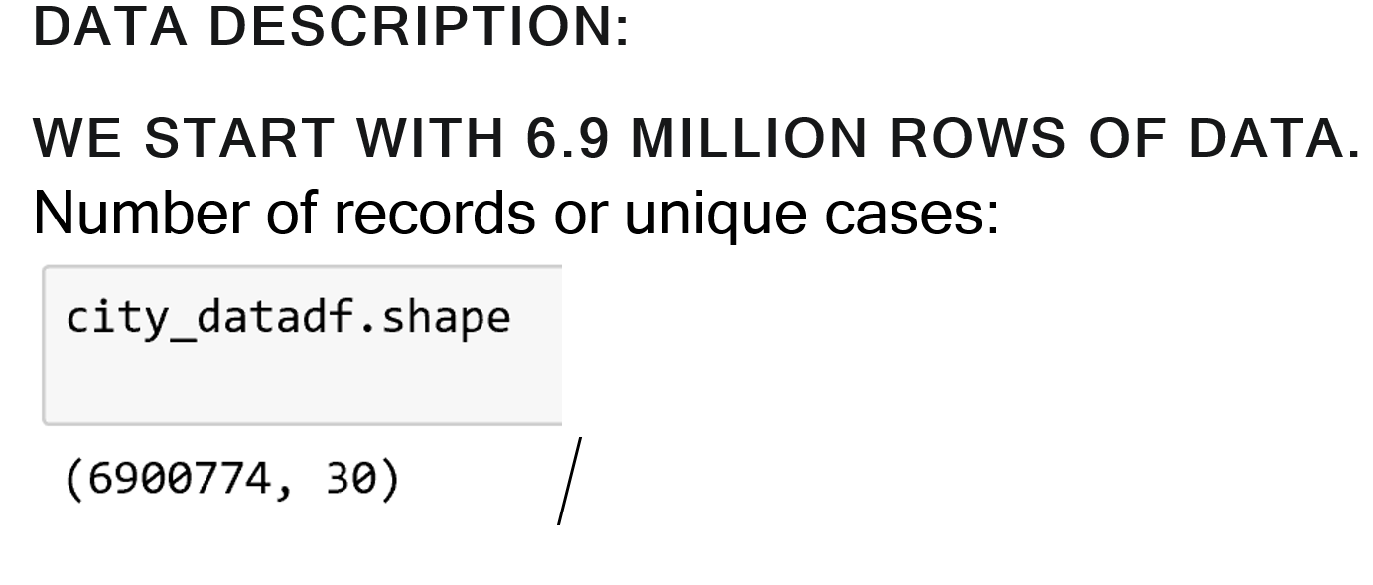
Datasets used for the project
We used three datasets for the project.
CHICAGO CRIMINAL ACTIVITY DATASET
This dataset reflects reported incidents of crime (with the exception of murders where data exists for each victim) that occurred in the City of Chicago from 2001 to present, minus the most recent seven days. Data is extracted from the Chicago Police Department's CLEAR (Citizen Law Enforcement Analysis and Reporting) system.
https://data.cityofchicago.org/Public-Safety/Crimes-2001-to-present/ijzp-q8t2
CHICAGO WEATHER CONDITION DATASET
This dataset provides weather conditions that covers the duration the CHICAGO CRIMINAL ACTIVITY DATA by various measurement types (such as temperature, cloudiness and pressure etc.) We get the data set from https://www.meteoblue.com/products/historyplus/download/basel_switzerland_2661604 - the only free data set we found which support as early as 2001 up to 2019.
CHICAGO POPULAR ATTRACTION DATASET
https://maps.googleapis.com/maps/api/place/textsearch/jsontext search api from google maps
Speaker: Divya

Slide 4
Challenges in the project
Humongous dataset – Chicago crime dataset has 6.9 million records to process.
Git source control and merging everyone's code under the widget.
Unlimited scope for the datasets.
Establishing relationship between the weather and crime on the particular day. Weather data wasn’t available easily.
Manage google map API calls efficiently.
Speaker: Divya

Slide 5
Crime count for every month
Story telling : We were interested in analyzing the occurrence and trend of the top five types of crimes based on reports logged by the City of Chicago and their trend over time and season (months).
Crime | Occurrences during the Entire Timeframe | Percent of Total
Theft | 1,453,930 | 21.1
Battery | 1,260,969 | 18.2
Criminal Damage | 786,779 | 11.4
Narcotics | 719,644 | 10.4
Assault | 430,611 | 6.2
TOTAL | 4,651,933 | 67.3
It is true that other categories of crime, chiefly homicide, though less in number have a higher degree of severity. However, the selection of the top five crimes was based entirely on the number of occurrences.
Speaker: Ramesh

Slide 6
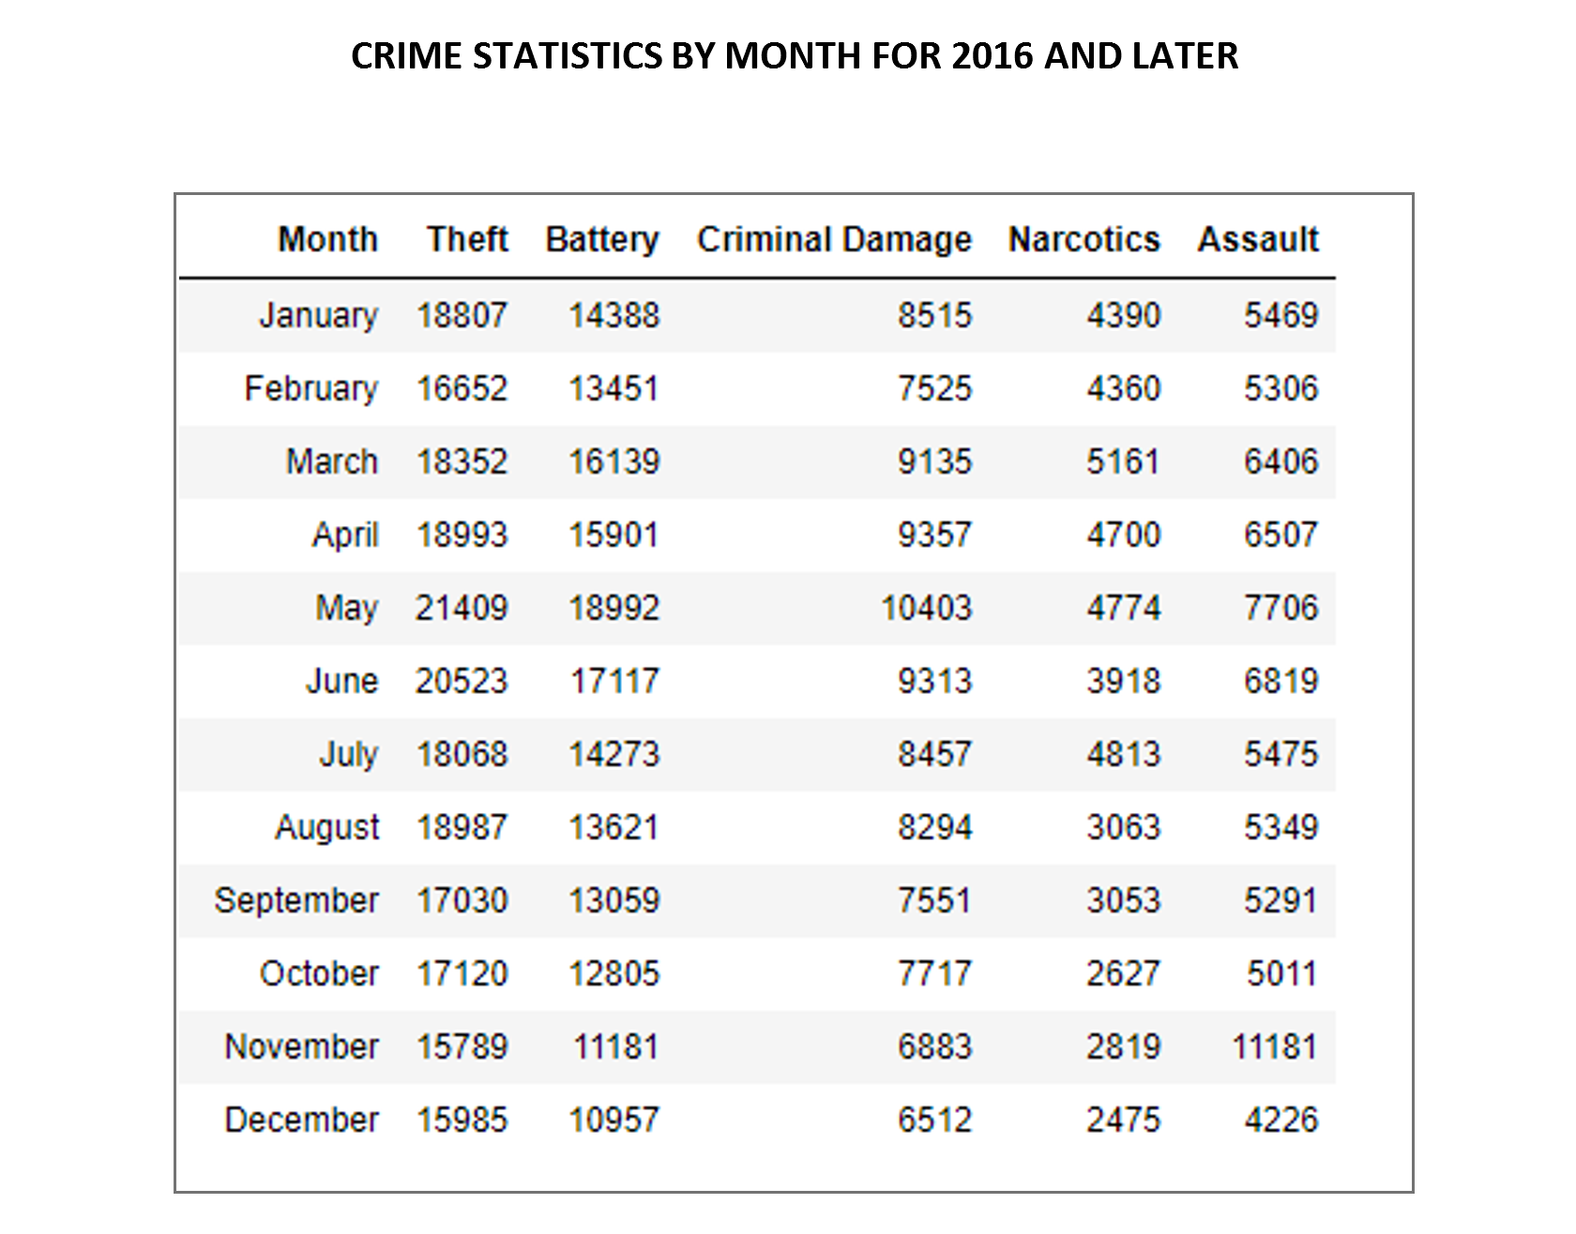
Inference from the Analysis
Speaker: Ramesh

Slide 7
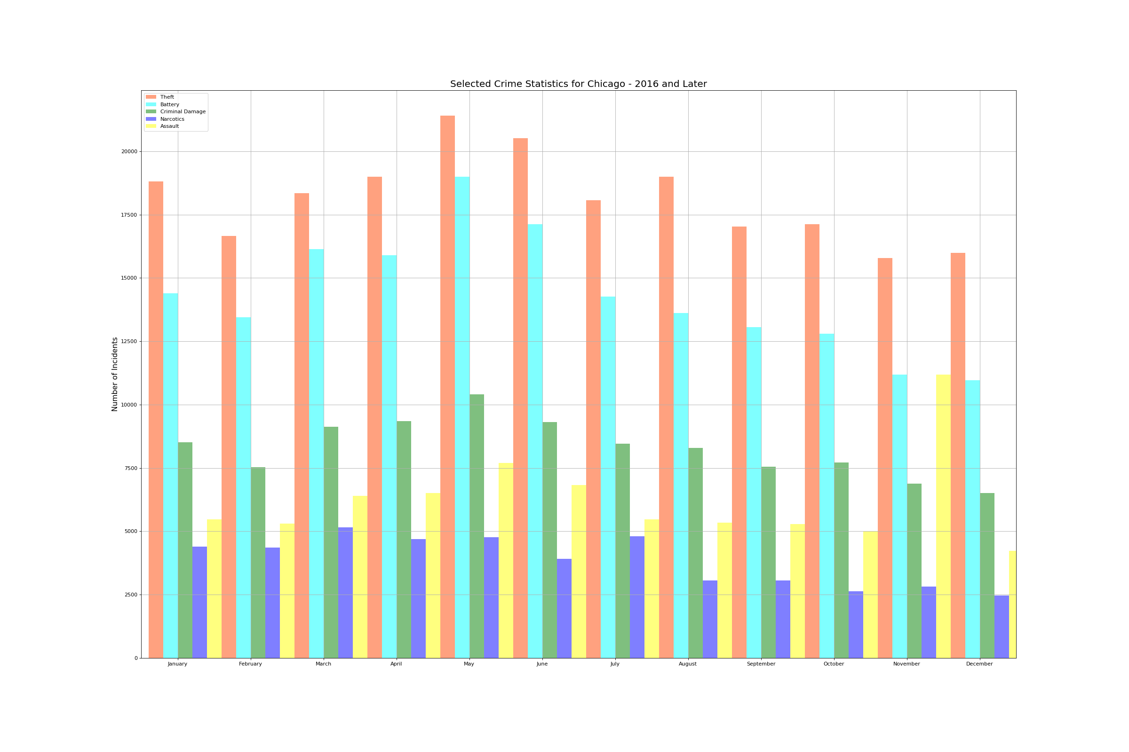
Inference plot
Speaker: Ramesh

Slide 8
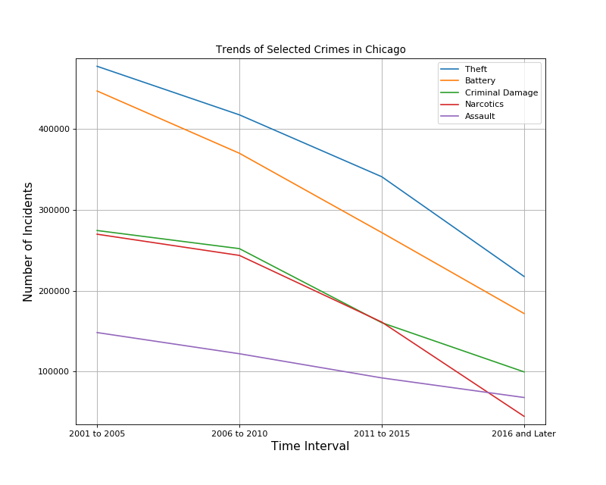
Inference from the Analysis
Following inferences were made based on the analysis:
Most of the selected crimes take place during the time when clement weather conditions prevail (May through August)
However, December and January show a much higher level of “thefts” compared to the other slow months; possibly triggered by the Holiday Season
The five crimes have been showing a decreasing trend since 2001 which is the first year of the dataset
Speaker: Ramesh

Slide 9
Effects of weather on crime
Story telling:
To check if weather conditions played a role on the crime rate and crime types.
The seasonal cycle of Chicago crime peaks during summer months, but not all types of crime are equally
susceptible to changes in temperature.
We looked at Chicago police crime data from a start date(Picked from the widget) to end date([picked from the widget), some million incidents, from homicides and battery to narcotics and theft.
Correlating those day-by-day crime records with changes daily temperature shows some types of crime are much more likely to increase when the weather is hotter and decrease when cooler.
Source: News articles- Chicago tribune, Wikipedia.
Speaker: Kevin
Notes:
What story were you interested in?
What crime type did you pick and why?
What is your inference?
Show your plot.
****Show the function widget of the code and show how to scale timeline and crime types.****
How you cleaned the weather data set.

Slide 10
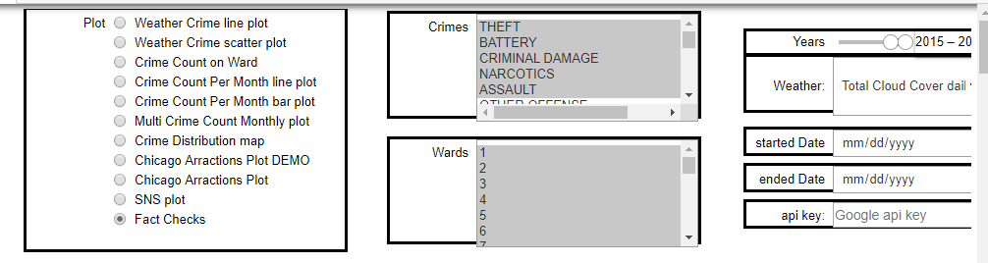
Widget functionality

Slide 11
Widget functionality
We used widget to pick the start date and end date to filter the datasets based on time. We also pick the type of plot from the widget.
To plot the incidents on the google map, we use widget and api key to access data from google maps.
Advantages of widget:
User can dynamically pick a timeline of his interest.
User can pick a crime type of is choice.
User’s API key is not visible to the starter program.
User can pick a Chicago Aldermanic ward(City of Chicago has 50 wards whose representatives are elected by the people) and plot the crime types in each ward for the selected crime types.
Users can dynamically pick a weather condition to plot the crime types.
Dataset is read only once for all the plots.
Speaker: Kevin

Slide 12
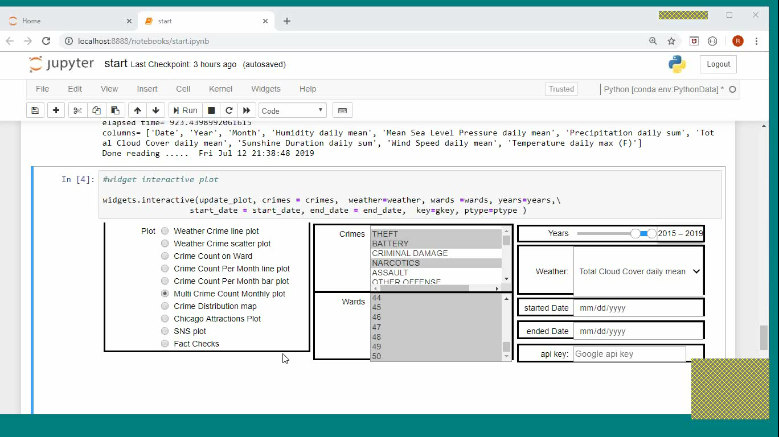
Show widget demo

Slide 13
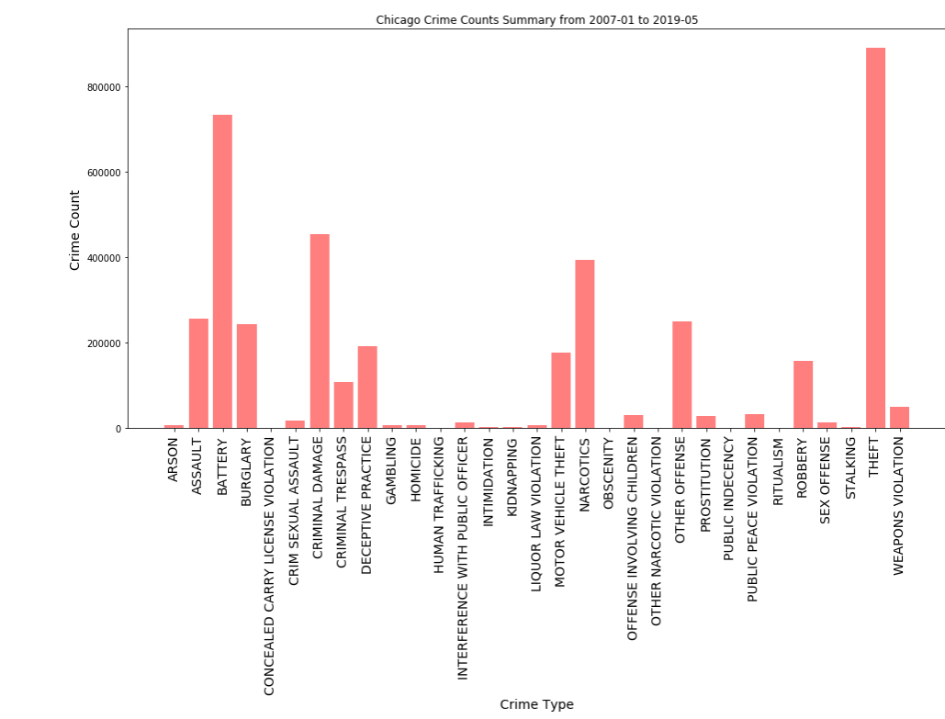
Crime Count Summary
Speaker: Kevin

Slide 14
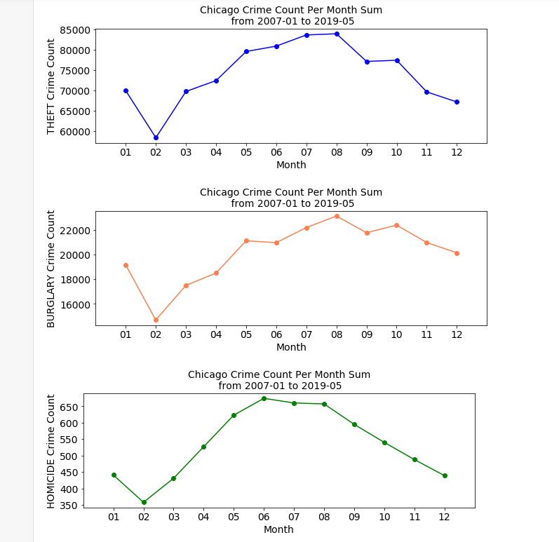
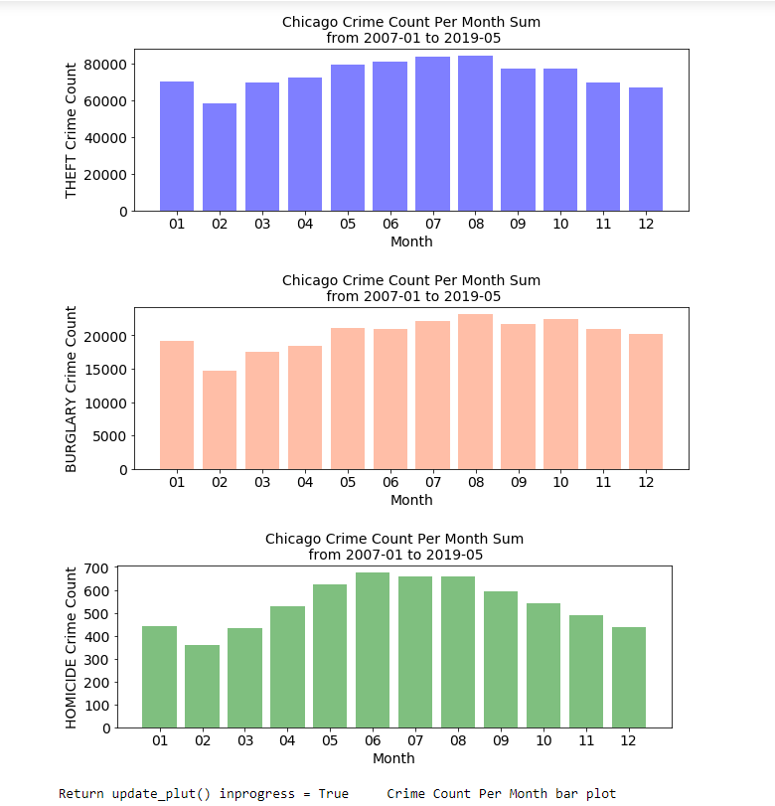
Crime counts per month
Speaker: Kevin

Slide 15
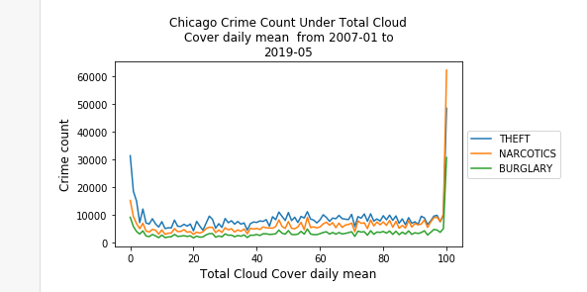
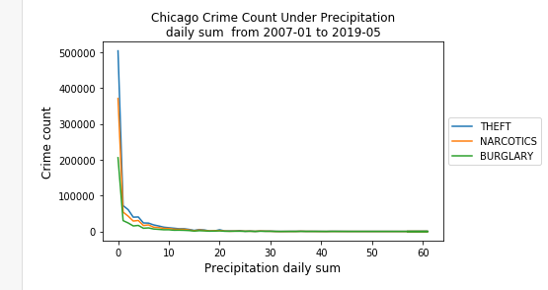
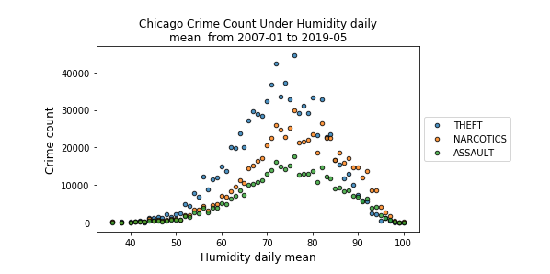
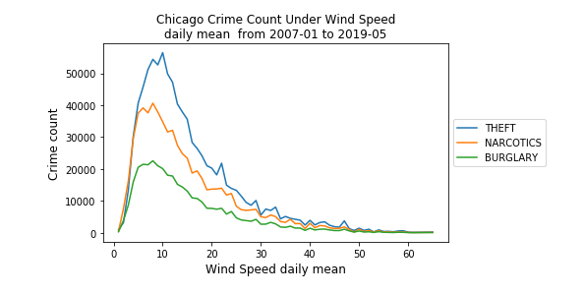
Crime and weather conditions
Speaker: Kevin

Slide 16
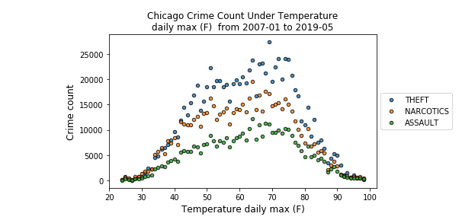
Crime and weather conditions
Speaker: Kevin

Slide 17
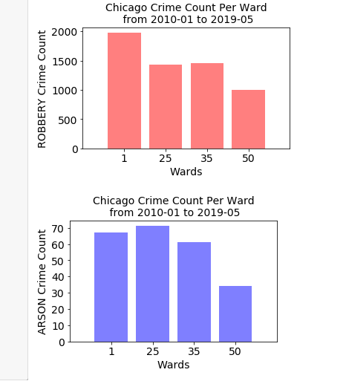
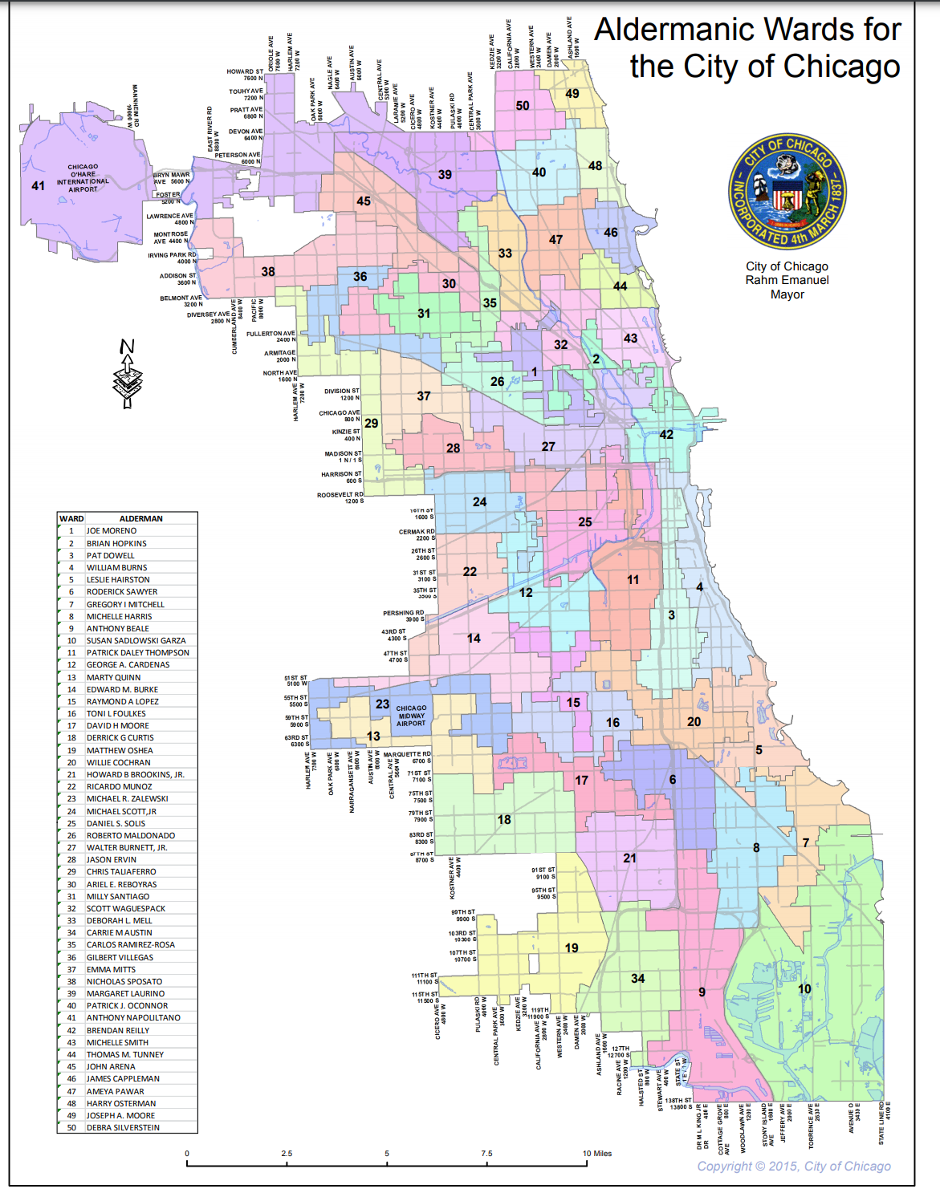
Crimes in Chicago Wards
Speaker: Kevin

Slide 18
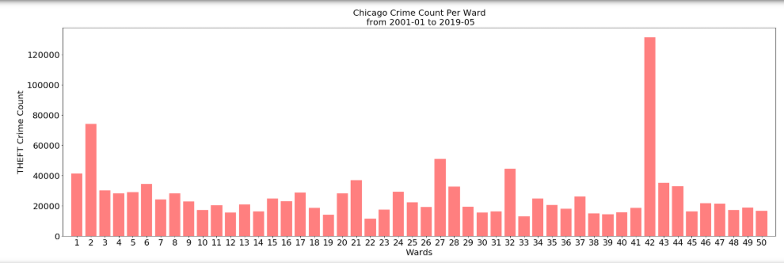
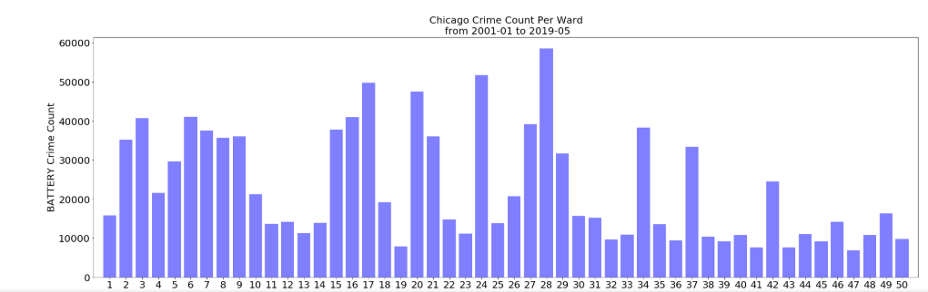
Crimes- THEFT and BATTERY in Chicago Wards
Speaker: Kevin

Slide 19
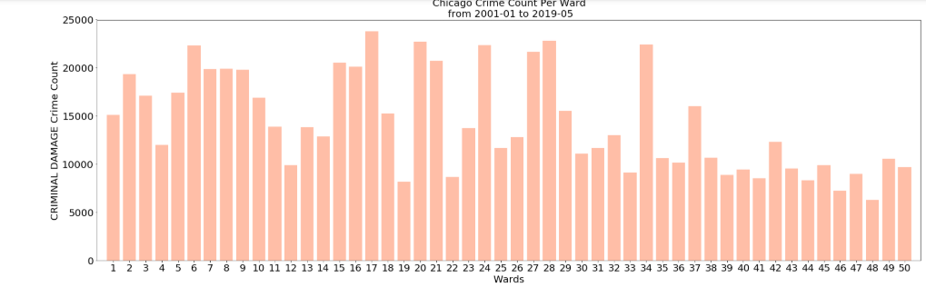
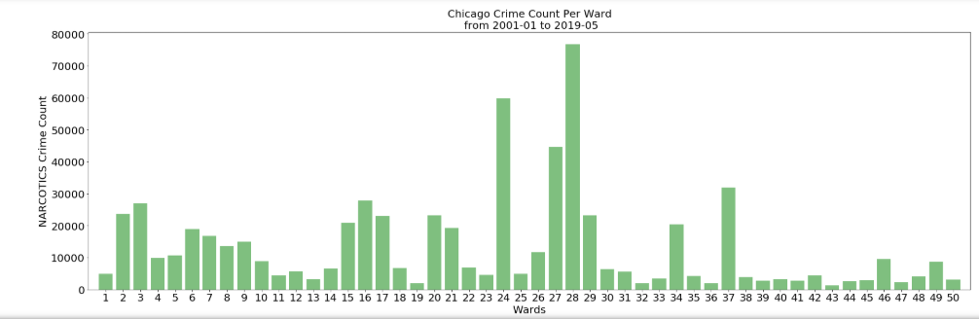
Crimes- Criminal Damage and Narcotics in Chicago Wards
Speaker: Kevin

Slide 20
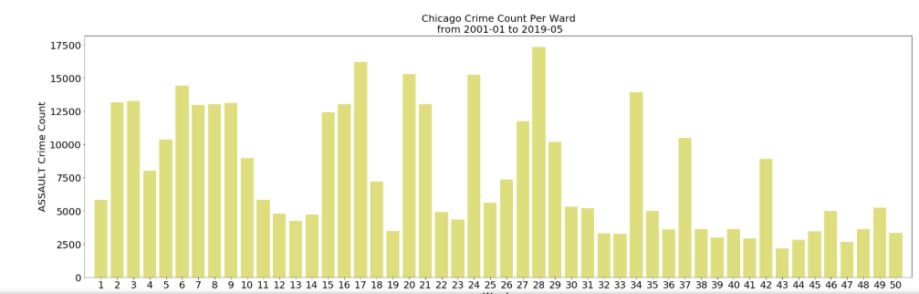
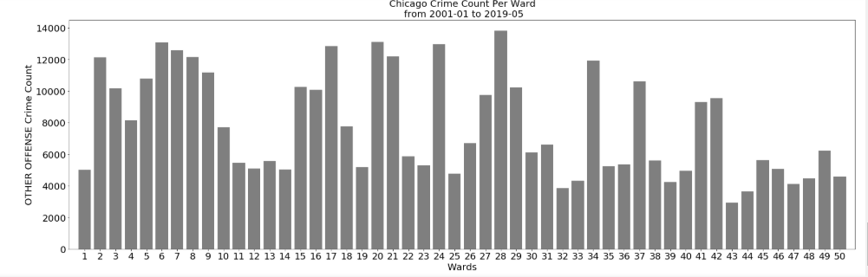
Crimes- Assault and Narcotics in Chicago Wards
Speaker: Kevin

Slide 21
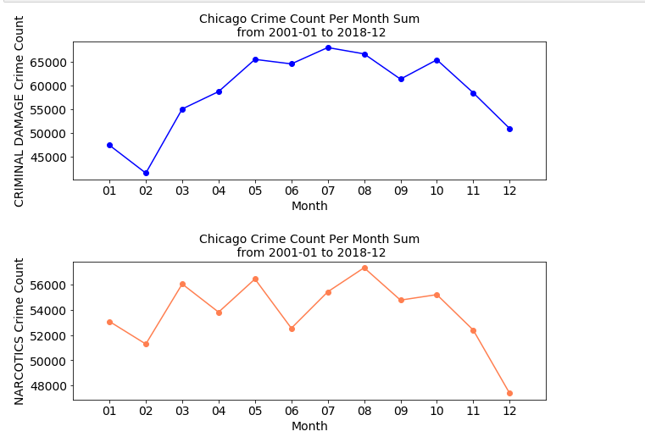
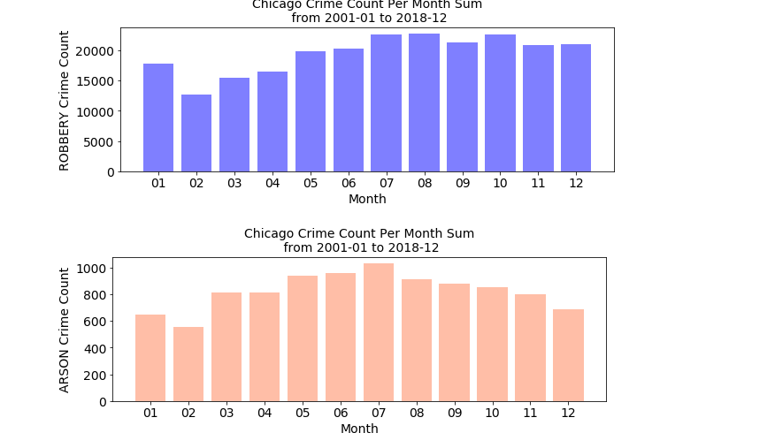
Report Monthly Crime Count by selecting specific year
Speaker: Kevin

Slide 22
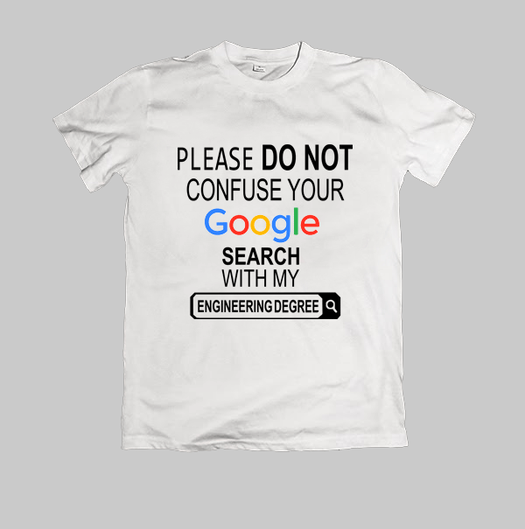
Criminal activity around popular attractions in Chicago
Story revolved around google text search , popular attractions and wanting to know how safe/unsafe the area around the tourist attractions are.
The popular attraction details were pulled from the Google text search API which returned the top 20 popular locations based on ratings and number of reviews.
Speaker: Harsha

Slide 23
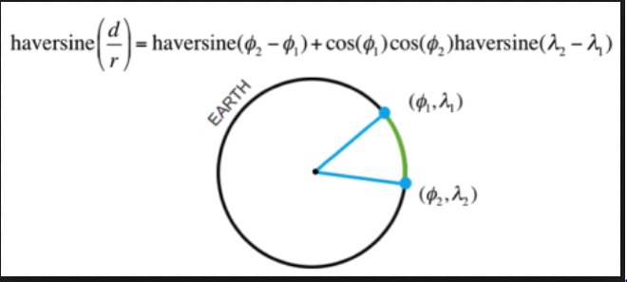
Challenges Faced during Plotting
The biggest challenge faced was with filtering out the crime locations around the popular attractions.
Given the high volume of data, there were a few options such as drawing an imaginary border around the popular attraction and get the crime locations within the area. Or grouping the popular attractions as well as the crime locations based on the Zip Code.
None of the above methods were as effective as the Haversine formula.
The Haversine formula is a special case of a more general formula in spherical trigonometry, the law of haversines, that relates the sides and angles of spherical triangles.

Slide 24
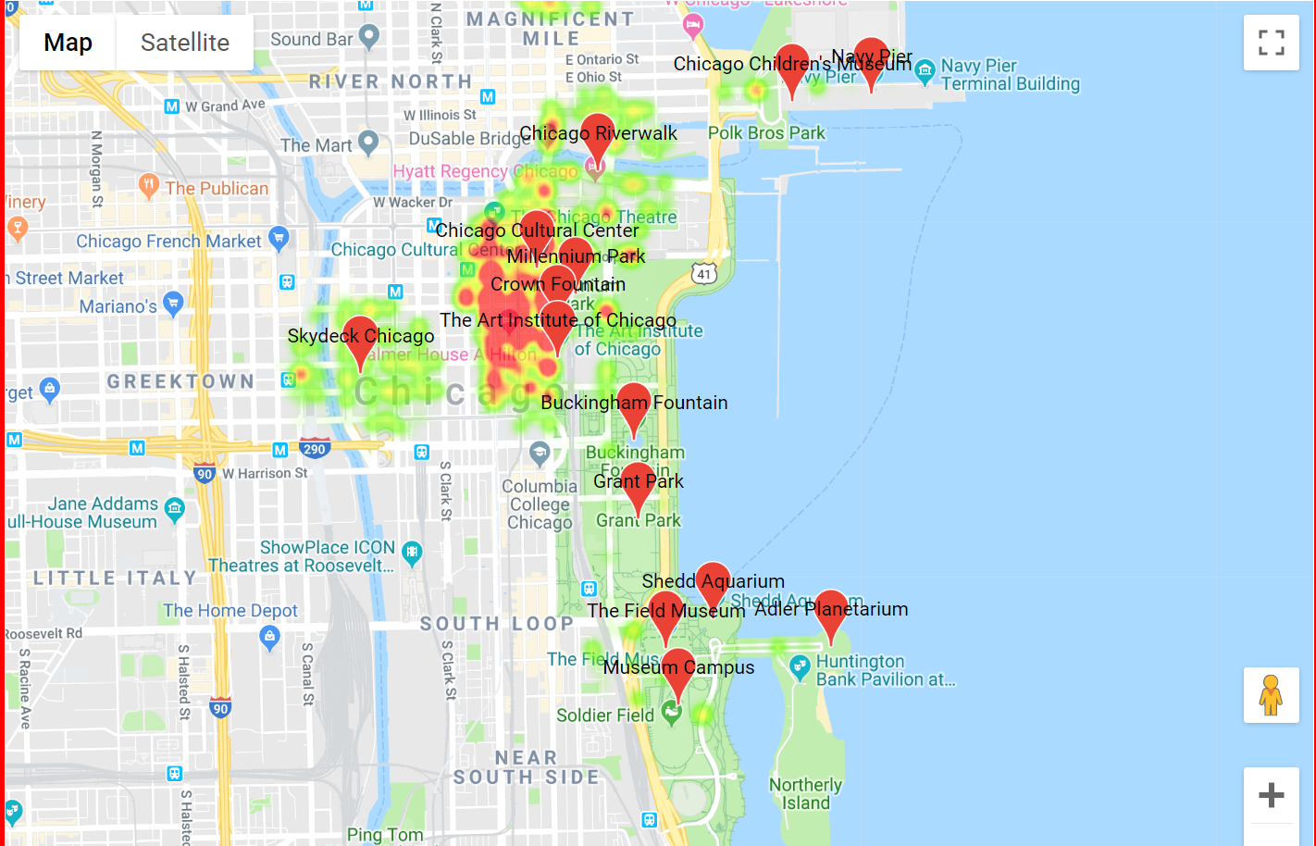
Final Results

Slide 25
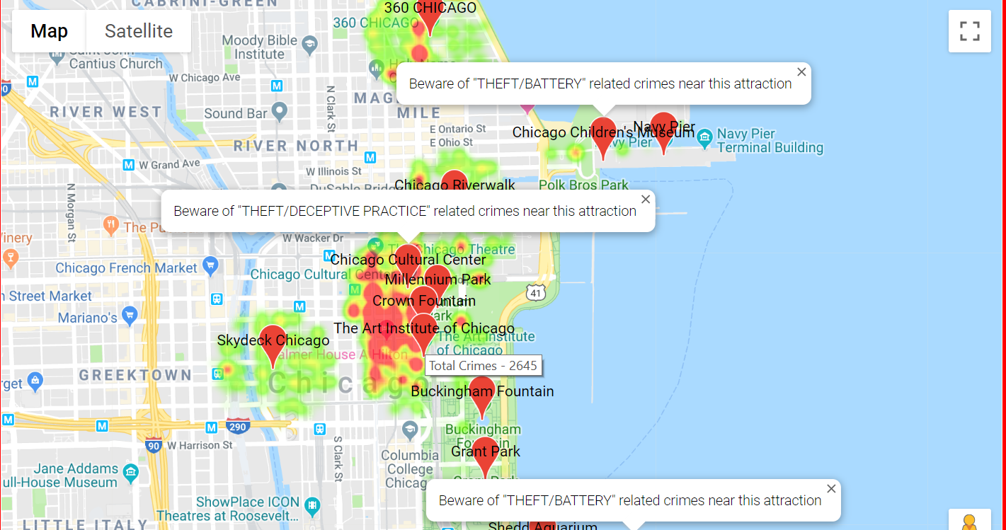
Additional Details per attraction

Slide 26
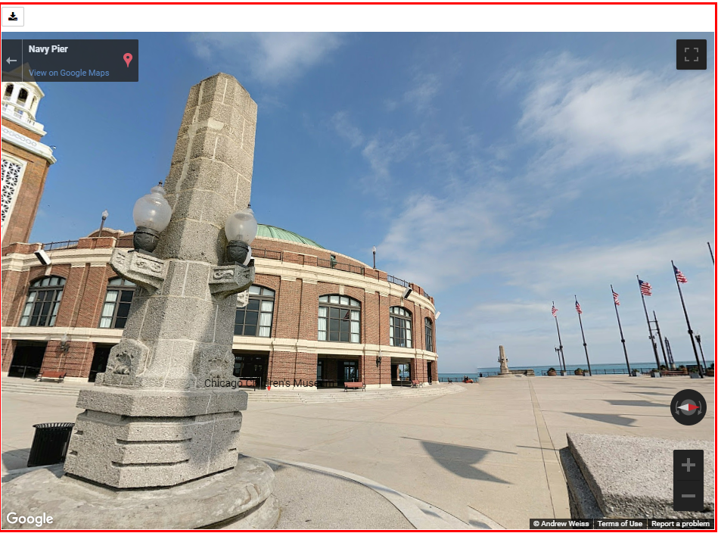
Additional Features – Street View

Slide 27
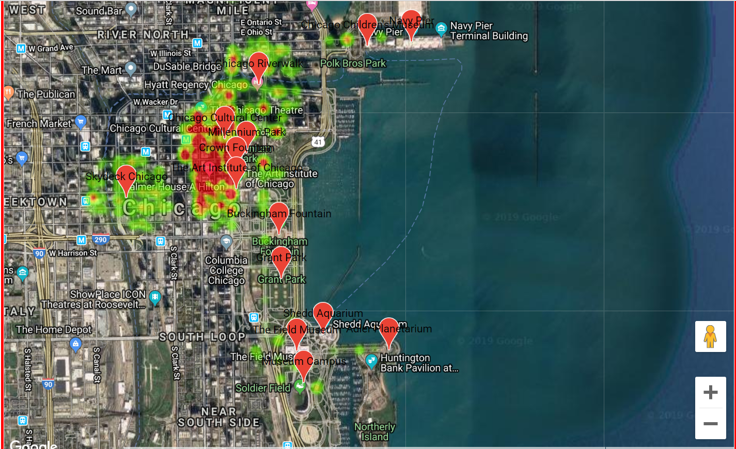
Conclusion
Speaker: Harsha

Slide 28
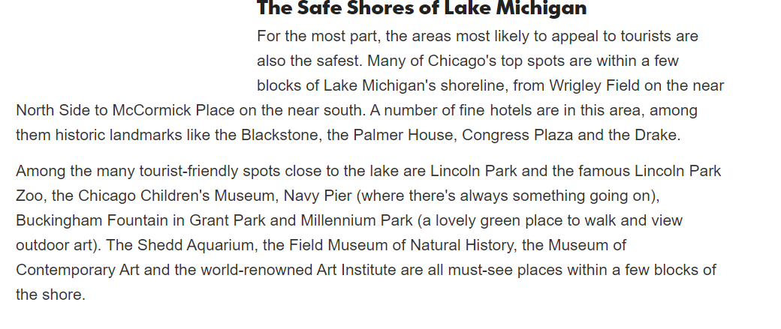
Fact Check

Slide 29
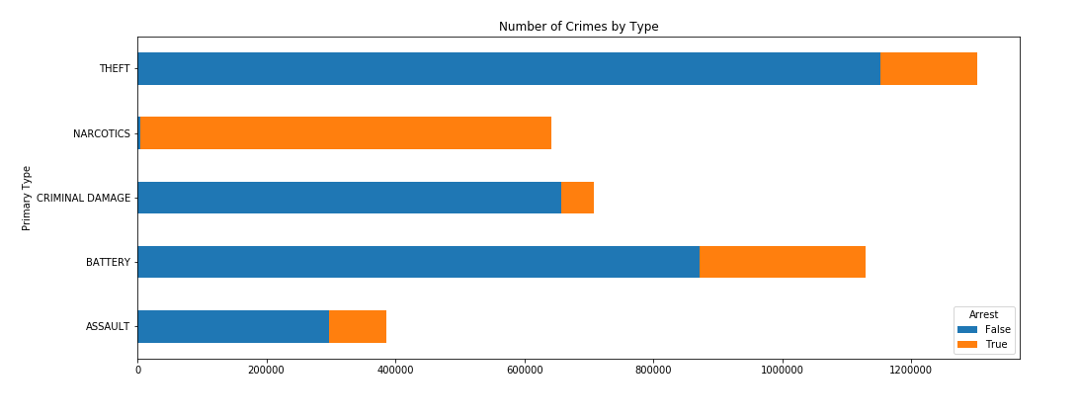
Crimes VS Arrests
Speaker: Harsha

Slide 30
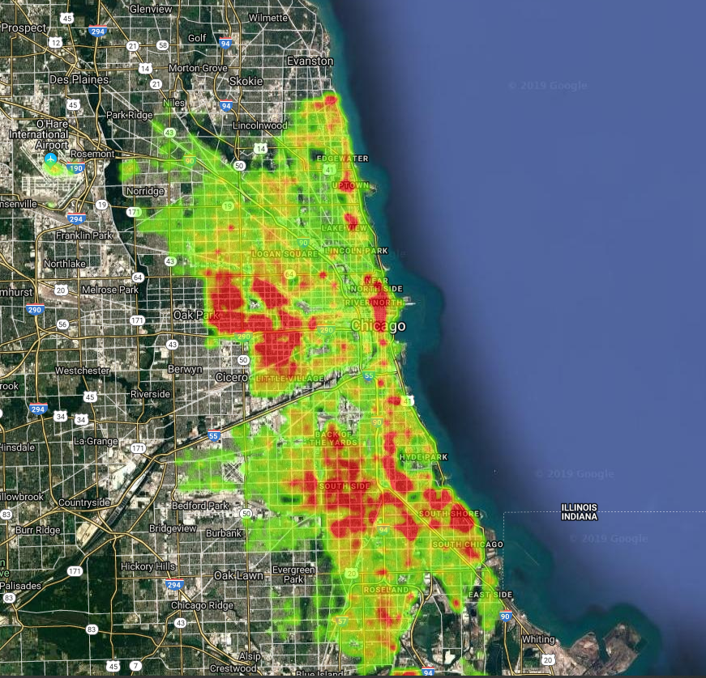
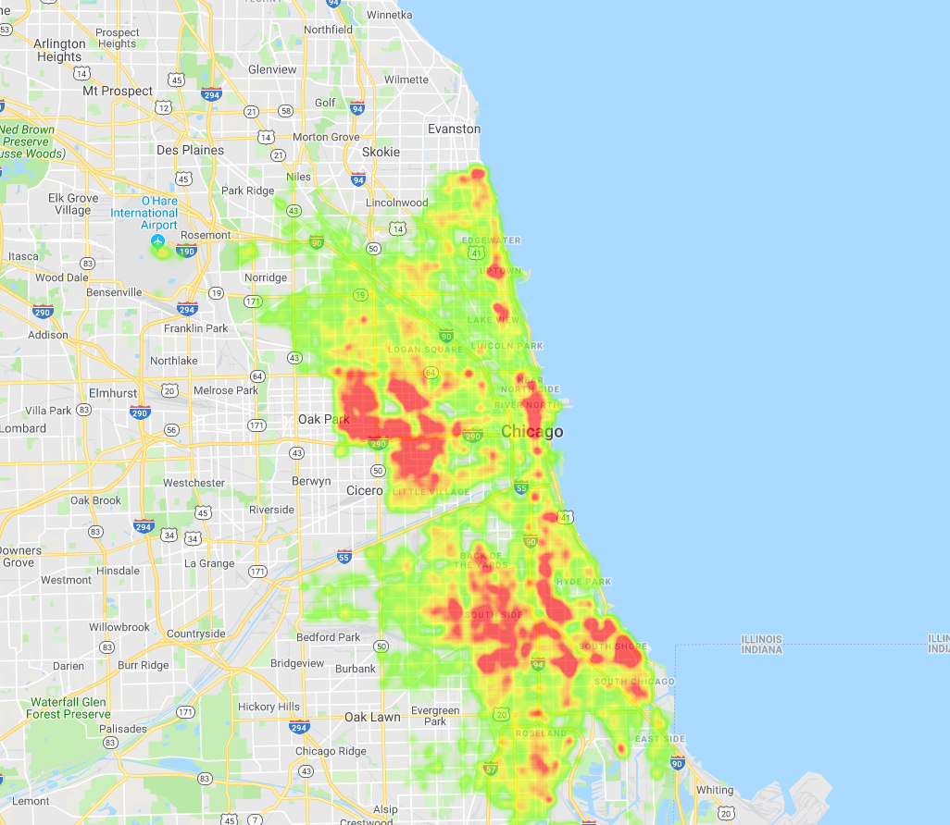
Crimes plotted on google maps to show safe and unsafe places
Speaker: Divya

Slide 31
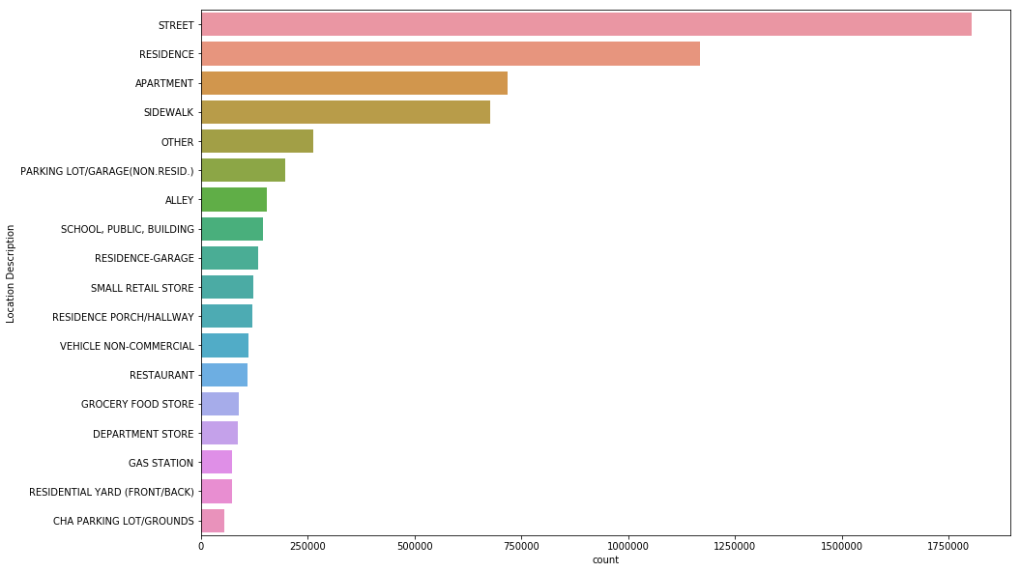
Locations of Criminal activities

Slide 32
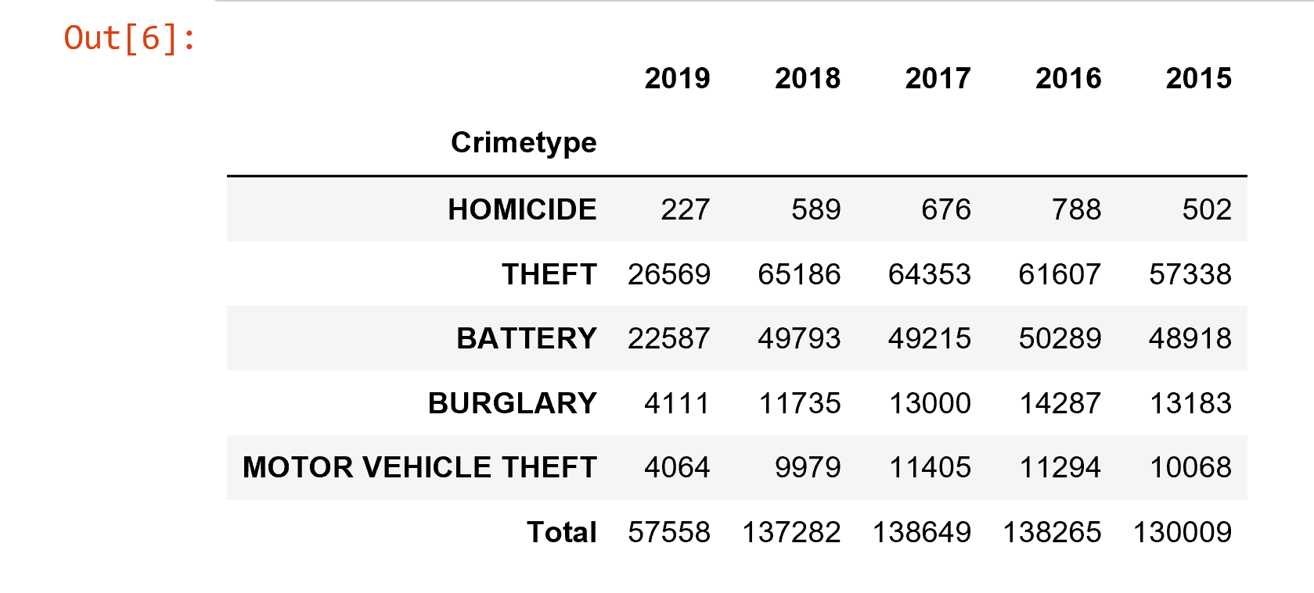
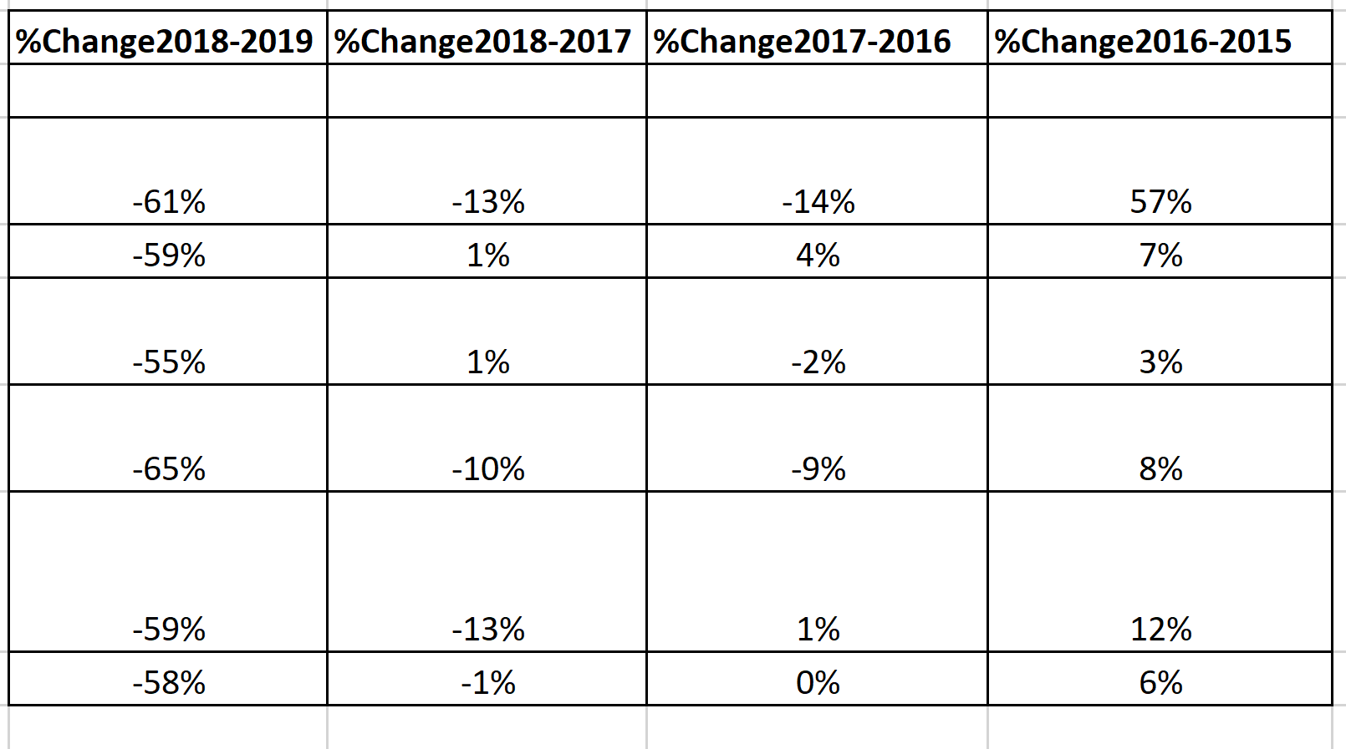
Changes in crime count over years
Speaker: Divya

Slide 33
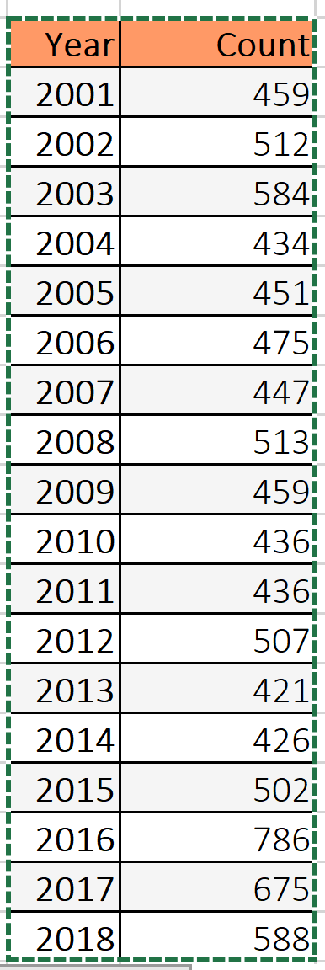
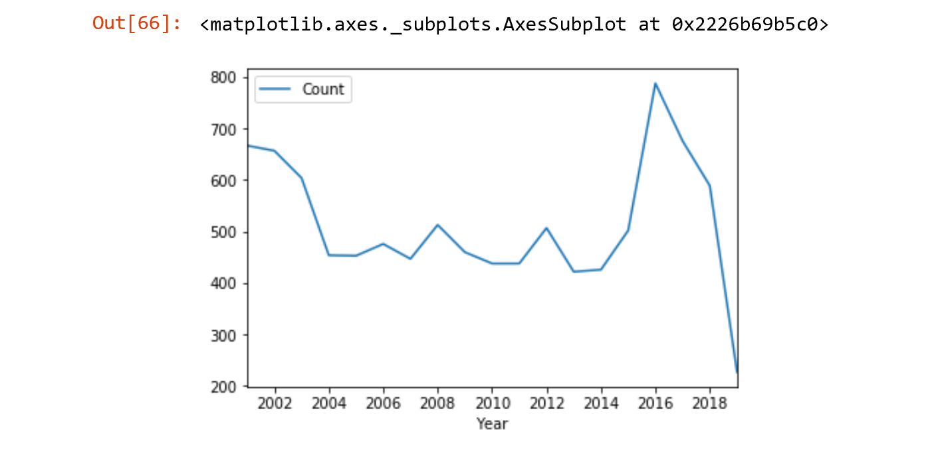
Fact checks or plots to match news articles and Wikipedia numbers
https://en.wikipedia.org/wiki/Crime_in_Chicago
Chicago was responsible for nearly half of 2016's increase in homicides in the US, though the nation's crime rates remain near historic lows
Speaker: Divya

Slide 34
Criminal activities increase with clement weather conditions.

Slide 35
Thank you

